Slide 1
Filtering and Ordering
SQL Day 2 Class

Slide 2
Learning Objectives
By the end of this lesson, you will be able to:
Filter SQL results with the WHERE clause.
Order results based on fields.
Notes:
Speaker Notes:
Today, we're diving deeper into SQL and focusing on two essential concepts: filtering data with the WHERE clause and ordering results based on specific fields.
These skills are crucial for extracting meaningful information from large datasets and customizing the way your SQL results are presented. So, let's get started!

Slide 3
Filtering and Ordering SQL Results
What is Filtering?
Filtering allows you to select a subset of rows from a table based on conditions.
Common filtering keywords: WHERE, AND, OR.
Example:
SELECT *
FROM products
WHERE price < 10 AND stock > 0;
Notes:
Speaker Notes:
Filtering is a fundamental concept in SQL, allowing you to refine your queries by specifying conditions.
With filtering, you can extract specific rows from a table that meet certain criteria, making it easier to work with targeted data.
In this example query, we're selecting all columns from the "products" table where the price is less than 10 and the stock is greater than 0. This helps us find affordable products that are currently in stock. Let's explore this further in our lesson today.

Slide 4
Filtering and Ordering SQL Results
What is Ordering?
Ordering sorts the result set by one or more columns in ascending or descending order.
The ORDER BY keyword is used.
Example:
SELECT *
FROM products
ORDER BY price DESC;
Notes:
Speaker Notes:
Another essential aspect of SQL is ordering, which allows you to sort the result set based on one or more columns in either ascending (ASC) or descending (DESC) order.
The "ORDER BY" keyword is used for this purpose, and it provides a structured way to arrange your data for better analysis and presentation.
Let's take a look at an example to see how ordering works in SQL. In this query, we're selecting all columns from the "products" table and ordering them by price in descending order (from highest to lowest). This can be useful when you want to find the most expensive products in your dataset.

Slide 5
Filtering and Ordering SQL Results
Key Takeaways:
Filtering reduces results to rows fulfilling a condition.
Ordering sorts results based on column values.
WHERE and ORDER BY are important keywords for manipulating query output.
Notes:
Speaker Notes:
As we wrap up this section, let's recap the key takeaways:
Filtering is a powerful technique that allows you to narrow down query results by specifying conditions, helping you focus on specific subsets of data.
Ordering allows you to arrange query results in a desired sequence based on column values, enhancing the presentation and analysis of your data.
In SQL, the "WHERE" and "ORDER BY" keywords play a crucial role in achieving these operations, providing you with the flexibility to control and customize your query output. These are essential tools in your SQL toolkit as you continue to explore the world of databases and data manipulation.

Slide 6
SQL Clause Sequencing
Every SQL statement has a logical flow driving how it processes, filters, groups, orders data through sequential clauses:
SELECT - Declare desired result set columns
FROM - Source tables to join/access
WHERE - Filter rows on conditions
GROUP BY - Aggregate to grouped rows
HAVING - Filter aggregated groups
ORDER BY - Sort output rows
Notes:
Speaker Notes:
Every SQL statement follows a logical flow that determines how it processes, filters, groups, and orders data. Understanding this sequence is crucial for crafting effective SQL queries.
Here's the typical flow:
SELECT: Declare the columns you want in the result set.
FROM: Specify the source tables to access or join.
WHERE: Filter rows based on conditions, narrowing down your dataset.
GROUP BY: If needed, group rows together for aggregation.
HAVING: Filter aggregated groups based on conditions.
ORDER BY: Sort the final output rows as desired.
This logical flow guides the SQL engine in processing your queries efficiently and producing the desired results.

Slide 7
SQL Clause Sequencing
The ordered clauses in SQL work collaboratively to handle data flow and transformations:
Later clauses receive the result set from prior clauses.
GROUP BY aggregates the WHERE filtered rows.
HAVING filters trim unnecessary data.
ORDER BY sorts the rows filtered.
Notes:
Speaker Notes:
The sequence of clauses in SQL is not arbitrary; it plays a crucial role in shaping the outcome of your query.
Each clause receives the result set generated by the preceding clauses.
GROUP BY, for example, operates on the rows filtered by the WHERE clause, allowing you to aggregate specific groups of data.
HAVING comes after GROUP BY and further filters the aggregated groups.
Finally, ORDER BY sorts the filtered rows to provide a well-organized and meaningful result set.
Understanding and correctly using the order of SQL clauses is key to crafting precise and efficient queries.

Slide 8
WHERE Clause
The WHERE clause allows you to filter rows from a table based on conditions.
This is extremely useful for narrowing down queries to get just the subset of data you need.
Operators: Comparison operators like =, !=, <, >, <=, >= can be used to filter data:
= Equal to
!= Not equal
< Less than
> Greater than
<= Less than or equal
>= Greater than or equal
BETWEEN operator
Notes:
Speaker Notes:
The WHERE clause is a powerful tool in SQL that enables you to filter rows from a table based on specified conditions.
This functionality is invaluable when you want to focus on a specific subset of data from a larger dataset.
You can use various comparison operators like "=", "!=", "<", ">", "<=", and ">=" to define the conditions.
These operators allow you to filter data based on equality, inequality, and numerical comparisons. Mastering the use of the WHERE clause is essential for precise data retrieval.

Slide 9
WHERE Clause
WHERE clauses work on string, numeric, and date/datetime data types.
Examples:
WHERE Price > 100 WHERE Name != 'Apple’
WHERE SaleDate < ‘2023-01-01’
Chain together operators with AND/OR to make more complex logical filters.
Example:
WHERE SalePrice > 500 AND ReleaseDate > '2020-01-01’
Notes:
Speaker Notes:
The WHERE clause is versatile and can be applied to different data types, including strings, numerics, and date/datetime values.
Here are some examples illustrating how you can use the WHERE clause to filter data based on conditions.
You can also create more complex logical filters by combining conditions using AND and OR operators. This allows you to precisely tailor your queries to retrieve the exact data you need for analysis or reporting.

Slide 10
WHERE Clause
Check for NULL values using the IS NULL and IS NOT NULL operators.
For example:
WHERE PhoneNumber = NULL
Would actually return no rows, even if there are NULL phone numbers!
Instead, use:
WHERE PhoneNumber IS NULL
Similarly, to exclude NULLs:
WHERE PhoneNumber IS NOT NULL
Notes:
Speaker Notes:
When dealing with NULL values in SQL, it's crucial to use the correct operators for checking.
Using "= NULL" won't return the expected results, as it doesn't work for NULL values. Instead, use "IS NULL" to check for NULLs.
To exclude NULL values, you can use "IS NOT NULL." These operators are essential for handling missing or unknown data in your queries accurately.

Slide 11
Combining Filter Conditions
SQL provides operators for combining multiple filter criteria in the WHERE clause:
AND: Includes rows where ALL conditions are TRUE.
OR: Includes rows where ANY conditions are TRUE.
NOT: Reverses condition to exclude instead of include.
Use Cases:
Filter by multi-criteria rules.
Group criteria into inclusion buckets.
Implement exclusion rules.
Notes:
Speaker Notes:
In SQL, you have powerful operators to combine multiple filter criteria in the WHERE clause.
AND ensures that ALL specified conditions must be TRUE for a row to be included in the result.
OR includes rows if ANY of the specified conditions is TRUE.
NOT is used to reverse a condition, excluding rows that meet the specified criteria.
These operators allow you to create complex filter rules, group conditions, and implement inclusion or exclusion rules in your queries, making them highly flexible and adaptable to various scenarios.

Slide 12
Combining Filter Conditions
Narrowing Criteria with AND
AND narrows query results by requiring rows to match ALL conditions.
Consider AND when you want:
Specific segments (Region AND Revenue).
Filter dimensions (Date AND Product).
Strict definitions (Price > 100 AND Units < 50).
Example:
WHERE Region = 'West' AND Sales > 100000
Rows must meet both criteria.
Notes:
Speaker Notes:
The AND operator in SQL is used to narrow down query results by requiring rows to satisfy ALL specified conditions.
It's especially useful in scenarios where you want to filter data based on specific segments, dimensions, or strict definitions.
In the provided example, we are using AND to filter rows where the region is 'West' and sales are greater than $100,000. Only rows that meet both of these criteria will be included in the result set.

Slide 13
Combining Filter Conditions
Using NOT to Exclude Filter Matches
NOT reverses the logic of filter conditions to EXCLUDE instead of INCLUDE matching rows.
Consider NOT when you want:
Exception reporting (Exclude top regions).
Data quality checks (NOT missing addresses).
Complementary slices (NOT recent customers).
Example:
WHERE LastOrdered IS NOT NULL
Notes:
Speaker Notes:
The NOT operator in SQL is used to reverse the logic of filter conditions, excluding rows that match the specified criteria.
This can be valuable in various scenarios, such as exception reporting, data quality checks, or creating complementary data slices.
In the provided example, we use NOT to exclude rows where the "LastOrdered" value is NULL, helping us identify customers who have placed orders recently.

Slide 14
Combining Filter Conditions
The OR operator widens the filter criteria, allowing rows to match if they satisfy ANY of the conditions.
Consider OR when you want:
Flexible searches (Brand A OR Brand B products).
Buckets of data (New OR Existing customers).
Criteria variations (Sales >= $1000 OR Volume > 500).
Example:
WHERE Region = 'West' OR Sales > 100000
Notes:
Speaker Notes:
In SQL, the OR operator broadens filter criteria, enabling rows to match if they meet ANY of the specified conditions.
This flexibility is valuable for various scenarios where you want to search for multiple options, group data into buckets, or accommodate different criteria variations.
In the provided example, we use OR to filter rows where the region is 'West' OR sales are greater than $100,000, allowing us to capture a broader set of data meeting either condition.

Slide 15
Pattern Matching
The LIKE operator allows you to match text patterns in string data rather than exact literal values.
The LIKE operator uses two wildcards for flexible pattern matching in strings:
% (Percent sign): Matches zero or more characters.
It's a substitute for any set of characters.
_ (Underscore): Matches a single character.
It's a placeholder for an individual unknown character.
Notes:
Speaker Notes:
SQL's LIKE operator is handy when you want to match text patterns in string data, rather than exact values.
It introduces two wildcards for flexible pattern matching:
% (Percent sign): This wildcard matches zero or more characters and serves as a substitute for any set of characters.
_ (Underscore): This wildcard matches a single character and acts as a placeholder for an individual unknown character.
Using LIKE with wildcards opens up a wide range of possibilities for searching, filtering, and querying text data with varying patterns.

Slide 16
Pattern Matching
Examples of Using LIKE Wildcards
WHERE Name LIKE 'Data%’
Values starting with "Data”
WHERE ProductCode LIKE '2%3’
Values starting with 2 and ending in 3
WHERE Phone LIKE '507-9__-____’
507 area code + 9XX + 4-digit number
WHERE Title NOT LIKE '%Analyst%’
You can also negate patterns with NOT LIKE
Notes:
Speaker Notes:
Let's explore some practical examples of using the LIKE operator with wildcards in SQL.
In the first example, we retrieve values starting with "Data" using the pattern 'Data%'.
The second example filters values starting with 2 and ending in 3 with '2%3'.
The third example matches phone numbers in the format '507-9XX-XXXX', where '9XX' represents any two digits.
Lastly, we use NOT LIKE to exclude rows where the title contains the word "Analyst." These examples illustrate the versatility of using LIKE to perform complex pattern-based searches.

Slide 17
Ordering Results Sets
Ordering Result Sets
The order of rows returned in an SQL query result matters greatly for effective analysis.
While filters narrow what rows come back, ordering controls presentation sequence.
Key reasons precise ordering is crucial:
Surface most important records first (Show best performing products first).
Detect patterns and outliers (Consistency checking ordered transactions).
Notes:
Speaker Notes:
The sequence in which rows appear in the result set of an SQL query is critical for effective analysis.
While filters determine which rows are included, ordering controls the presentation sequence.
Precise ordering is crucial for various reasons:
It allows you to surface the most important records first, which can be useful for showing the best-performing products or prioritizing results.
It helps in detecting patterns and outliers, especially in scenarios where consistency is checked in ordered transactions.

Slide 18
Ordering Results Sets
ASC Order - Low to High
The ASC keyword applied in ORDER BY sorts result set rows in ascending order, from lowest to highest value, for the specified column.
Key behaviors:
Numbers ascend lowest to highest value (1, 5, 10, 100).
Dates ascend earliest to latest ('2020-01-01', '2022-05-05').
Text sorts alphabetically A-Z ('Apple', 'Banana', 'Orange').
Used by default if no order specified.
Notes:
Speaker Notes:
The ASC keyword in SQL's ORDER BY clause is used to sort result set rows in ascending order.
When applied, it arranges data from the lowest to the highest value for the specified column.
Key behaviors include sorting numbers from smallest to largest, dates from earliest to latest, and text in alphabetical A-Z order.
It's important to note that ASC order is used by default if no specific ordering is specified in the query. This default behavior can be useful in many scenarios.

Slide 19
Ordering Results Sets
DESC Order - High to Low
The DESC keyword applied in ORDER BY sorts result set rows in descending order, from highest to lowest value, for the specified column.
Key behaviors:
Numbers descend highest to lowest
(100, 10, 5, 1)
Dates descend latest to earliest
('2022-05-05', '2020-01-01')
Text sorts Z-A alphabetically
('Orange', 'Banana', 'Apple')
Notes:
Speaker Notes:
The ASC keyword in SQL's ORDER BY clause is used to sort result set rows in ascending order.
When applied, it arranges data from the lowest to the highest value for the specified column.
Key behaviors include sorting numbers from smallest to largest, dates from earliest to latest, and text in alphabetical A-Z order.
It's important to note that ASC order is used by default if no specific ordering is specified in the query. This default behavior can be useful in many scenarios.

Slide 20
SQL Clause Sequencing
Key Takeaways
Internalize these key points:
Filter Rows Concisely with WHERE
Add precise conditions selecting only the most essential data.
Every row evaluated puts load on the database.
Sort Results Clearly with ORDER BY
Sequence result sets suitably for usage based on logical rules over columns indicating importance, priority, and structure.
Optimize Gracefully For Pace
The database engine parses SQL syntax and determines efficient execution plans.
Avoid overly complex logic when simpler approaches suffice.
.
Notes:
Speaker Notes:
As you continue to learn and work with SQL, remember these key takeaways:
Filter Rows Concisely with WHERE: Be precise in your filtering conditions to retrieve only the necessary data. Each row evaluated adds load to the database.
Sort Results Clearly with ORDER BY: Arrange your result sets logically, considering the importance, priority, and structure of the data.
Optimize Gracefully For Pace: The database engine interprets SQL syntax and devises efficient execution plans. Strive for simplicity in your queries; choose straightforward approaches over overly complex logic when possible.

Slide 21
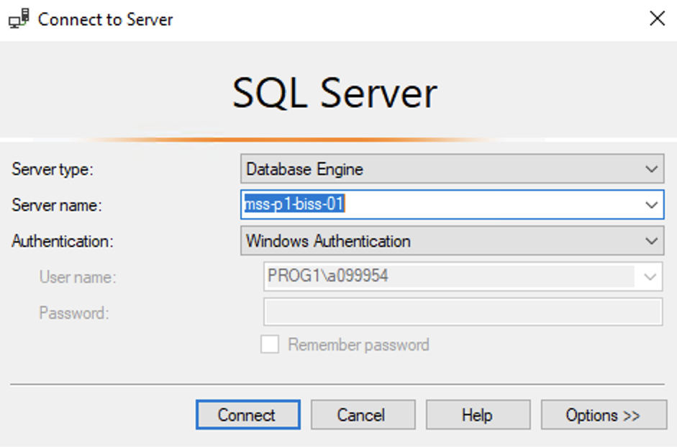
Hands On Examples
Using the AdventureWorks2012 Database
Please open up SSMS
Connect to BISS
Server = mss-p1-biss-01

Slide 22
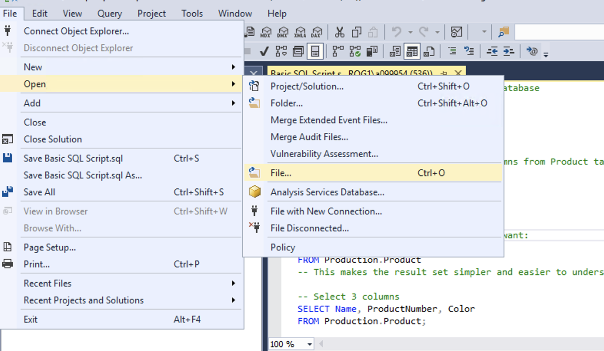
Hands On Examples
Click File -> Open -> File

Slide 23
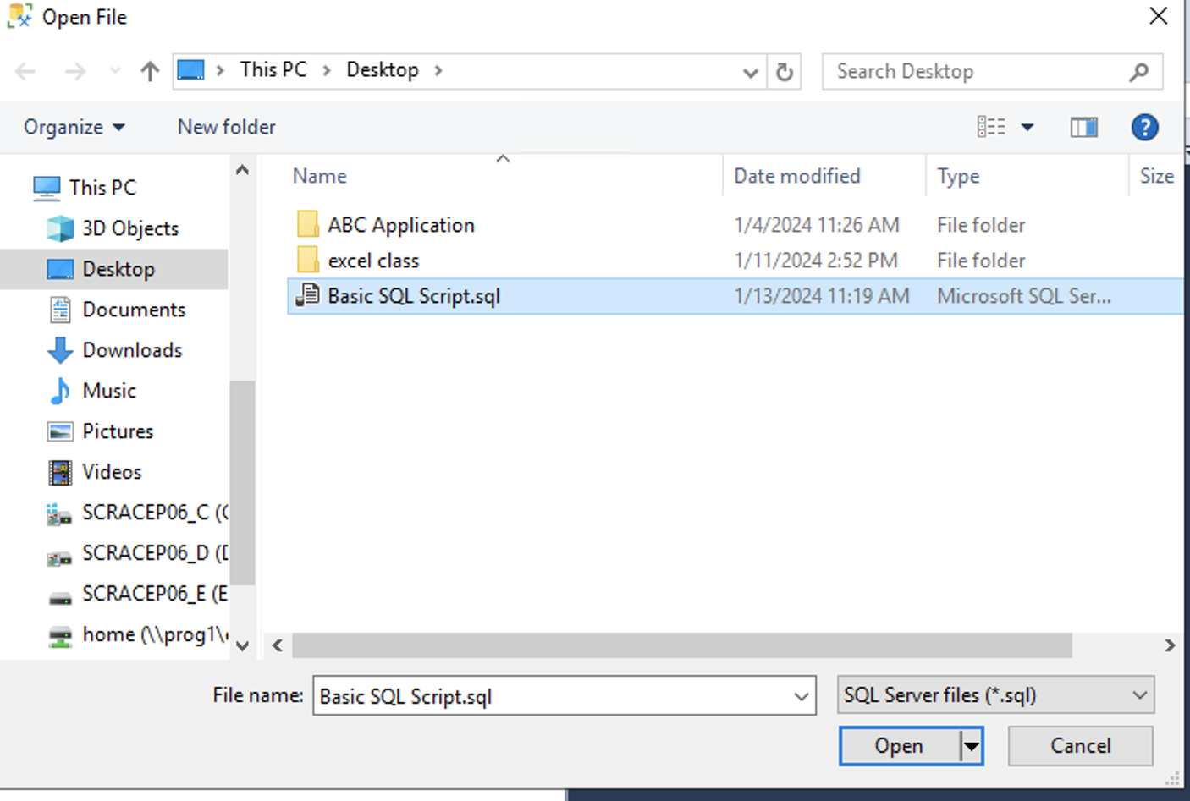
Hands On Examples
Open the SQL Day 2 Filtering and Ordering Script.sql file
Notes:
Walk through each function

Slide 24
Hands On Examples
Using the AdventureWorks2012 Database
Please open up SSMS
Connect to BISS
Server = mss-p1-biss-01

Slide 25
Hands On Examples
Click File -> Open -> File

Slide 26
Hands On Examples
Open the SQL Day 2 Filtering and Ordering Script.sql file
Notes:
Walk through each function

Slide 27
Exercise
Open the Day 2 Exercise.sql file
Answer the questions from each section
Notes:
Answers are stored in the Exercise Answers.sql file

